Slide 1



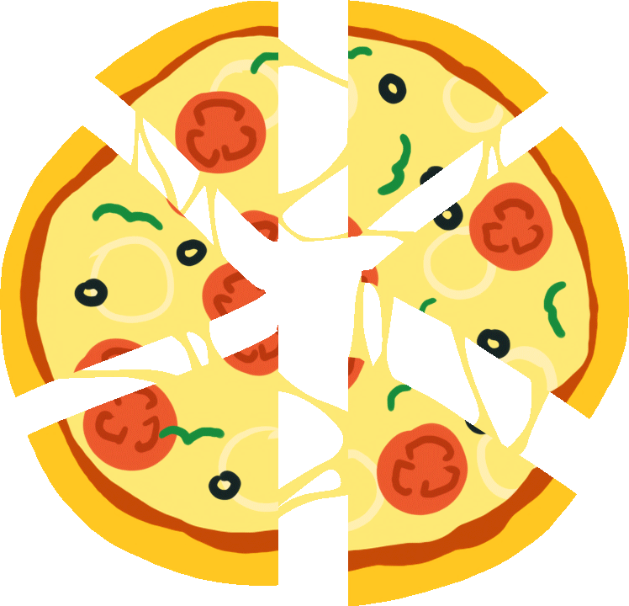




Delicious Pizza for Everyone!
FACTORY
PATTERN
@reallygreatsite

Slide 2



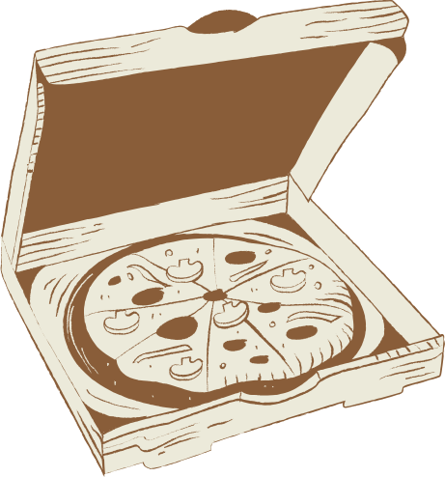
Chef
Dung and
Chef Khai
hello, we are the main chef and owner of great pizza.
Here, we are going to learn how to prepare some delicious pizza within 30 minutes.

Slide 3
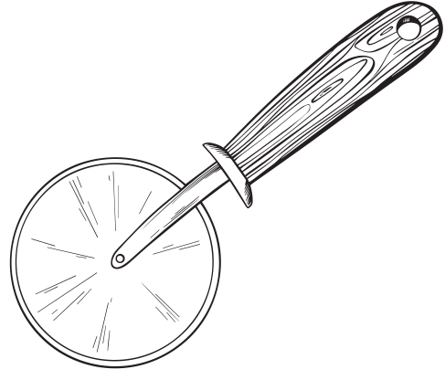
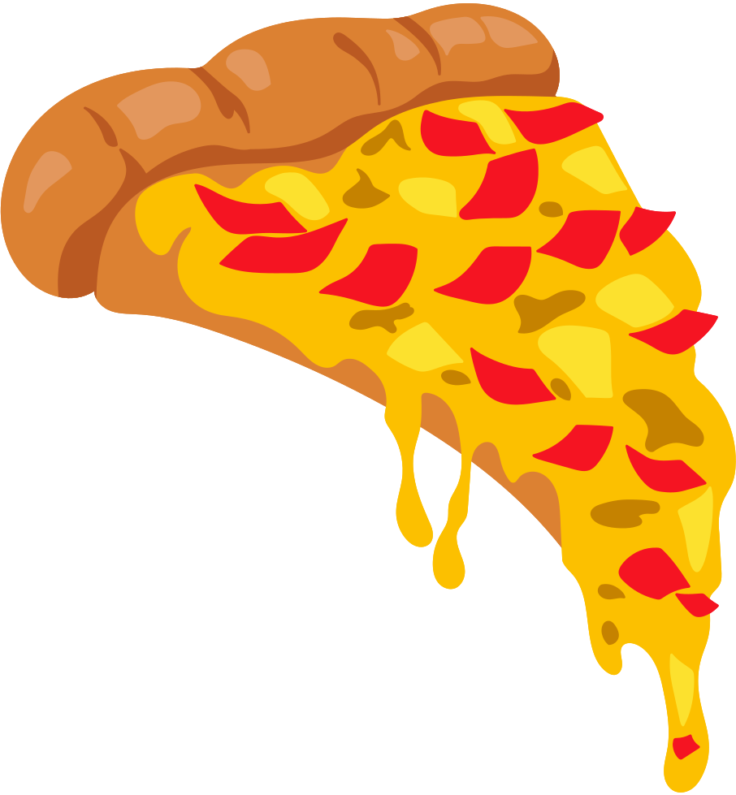
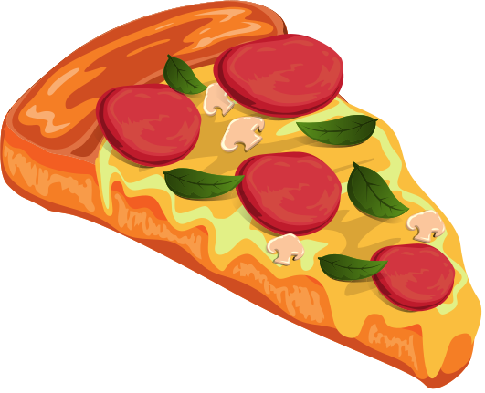
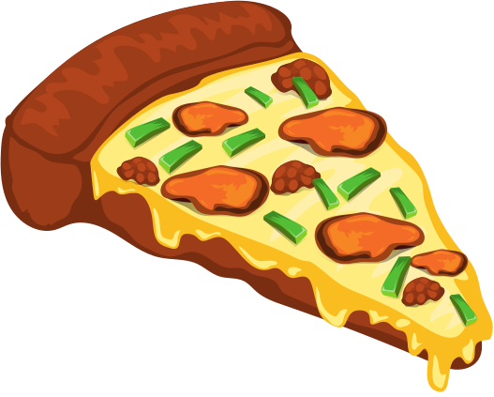
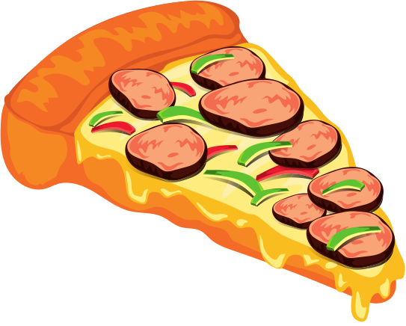
Table of contents
Problem
THe dependency
inversion principle
Demo
conclusion

Slide 4
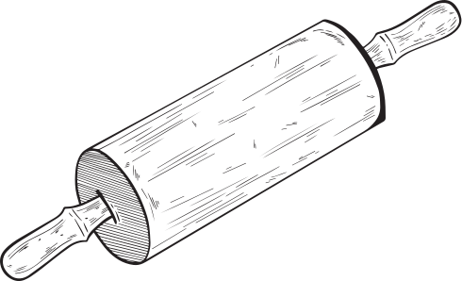
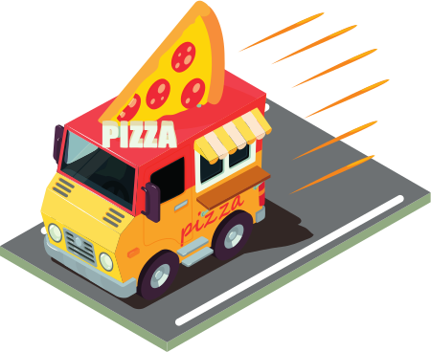
Problem?
The Franchises are using the factory to create pizzas, but starting to employ their own procedure.
.

Slide 5

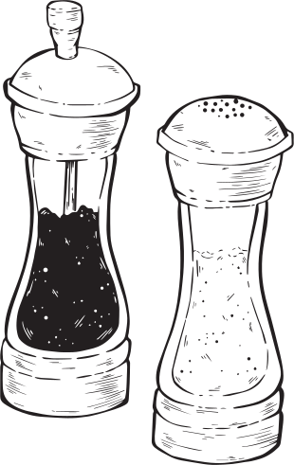
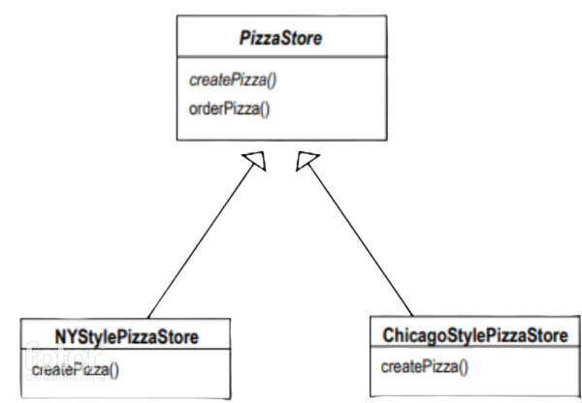
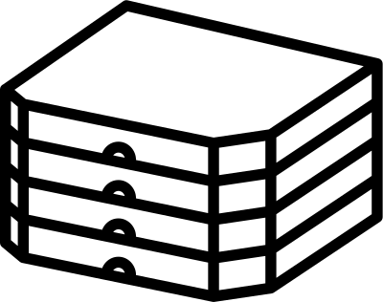

The abstract method
The creator class
We will have createPizza() method to make the right kind of pizza. With each subclass of Pizzastore have createPizza() method.

Slide 6
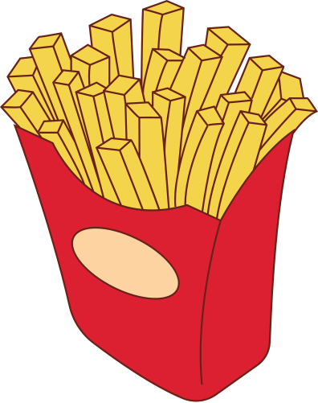
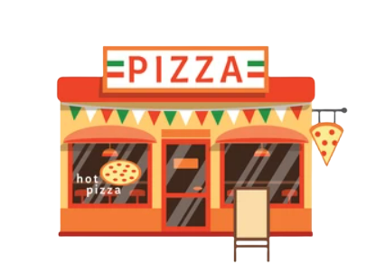
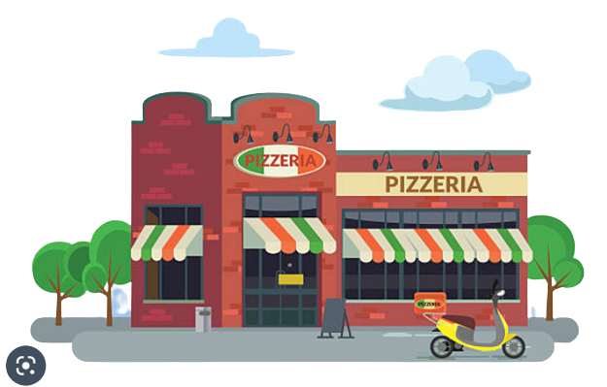
Pizza Store
NewYork style
Chicago style

Slide 7

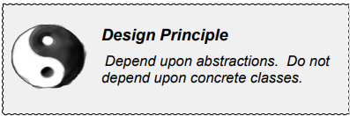
The Dependency Inversion Principle

Slide 8
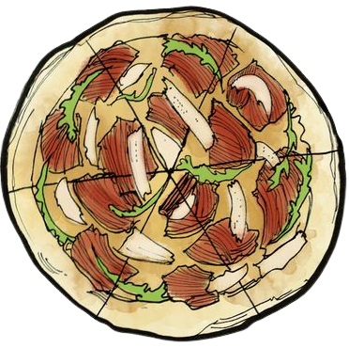

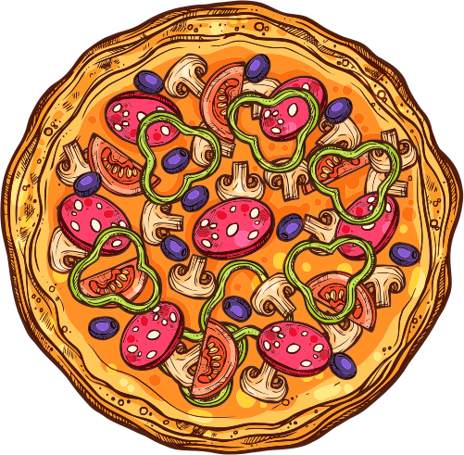
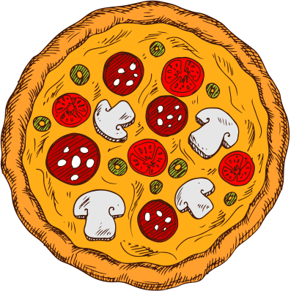
Our Variant
Clam
Cheese
vegies
pepperoni
delicious pizza with
clam
delicious pizza with cheese
delicious pizza with vegetable
delicious pizza with pepperoni

Slide 9
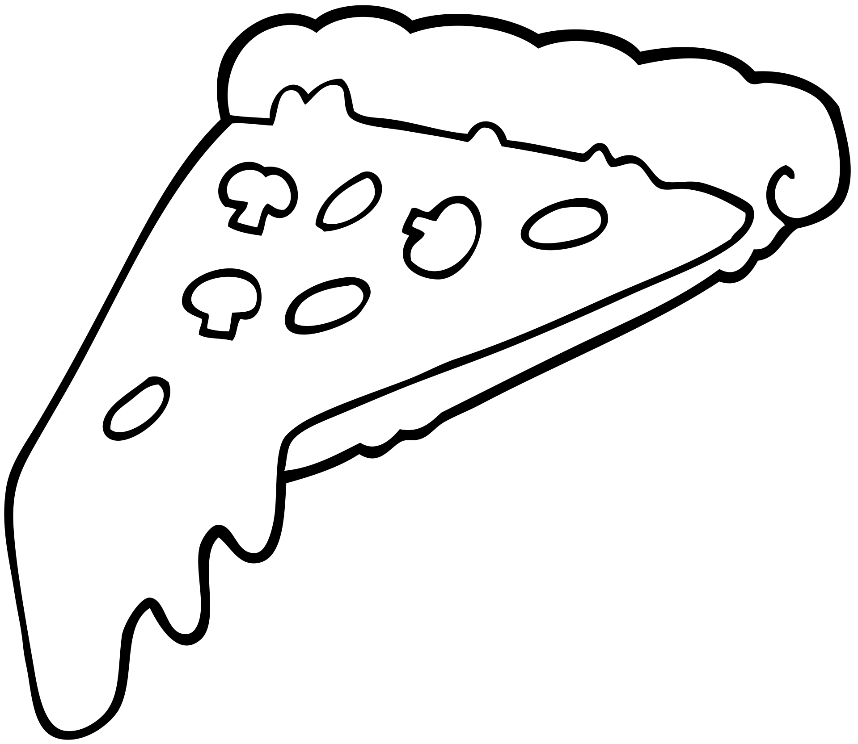
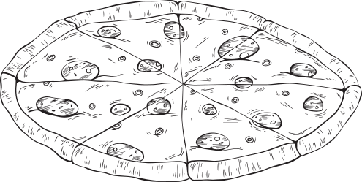
Demo

Slide 10

Pizza Boxcar Present
THANK
YOU
@reallygreatsite

